Slide 1
Elementary sorting techniques
Bubble, selection and Insertion sort

Slide 2
Bubble sort
Simplest sorting Algorithm.
It works by repeatedly swapping the adjacent elements if they are in the wrong order.
Algorithm:
traverse from left and compare adjacent elements and the higher one is placed at right side.
In this way, the largest element is moved to the rightmost end at first.
This process is then continued to find the second largest and place it and so on until the data is sorted.

Slide 3
Working example: On board

Slide 4
Code discussion:
int n = arr.size();
for (int i = 0; i < n - 1; ++i) {
for (int j = 0; j < n - i - 1; ++j) {
if (arr[j] > arr[j + 1]) {
int temp = arr[j];
arr[j] = arr[j + 1];
arr[j + 1] = temp;
}
}
}

Slide 5
Complexity and analysis
Time Complexity: O(N),O(N²), O(N²)
Auxiliary Space: O(1)
Advantages of Bubble Sort:
  Bubble sort is easy to understand and implement.
  In place: It does not require any additional memory space.
  It is a stable sorting algorithm, meaning that elements with the same key value maintain their relative order in the sorted output.
Disadvantages of Bubble Sort:
  Bubble sort has a time complexity of O(N²) which makes it very slow for large data sets.

Slide 6
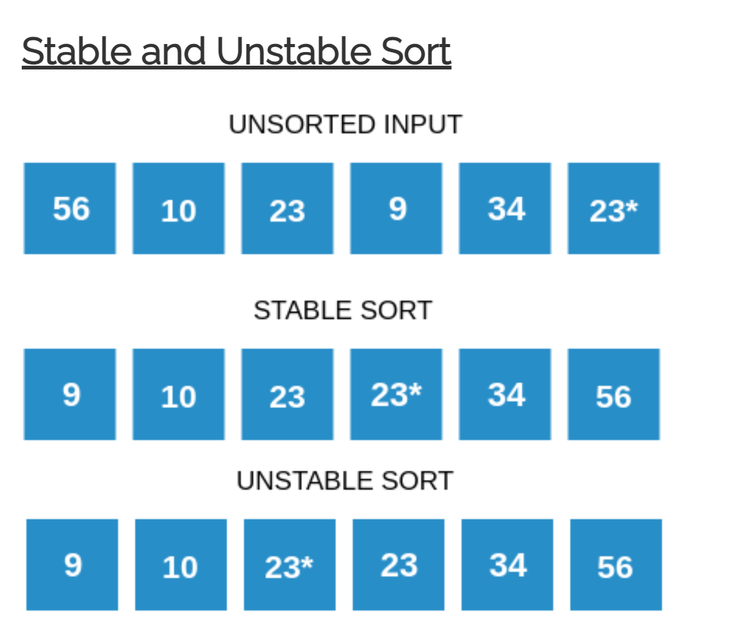

Slide 7
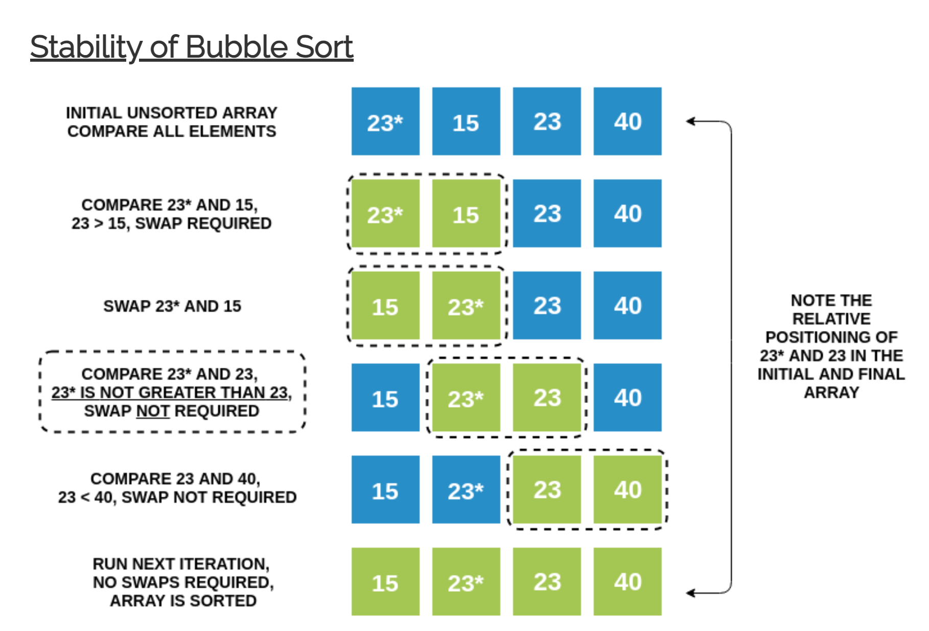

Slide 8
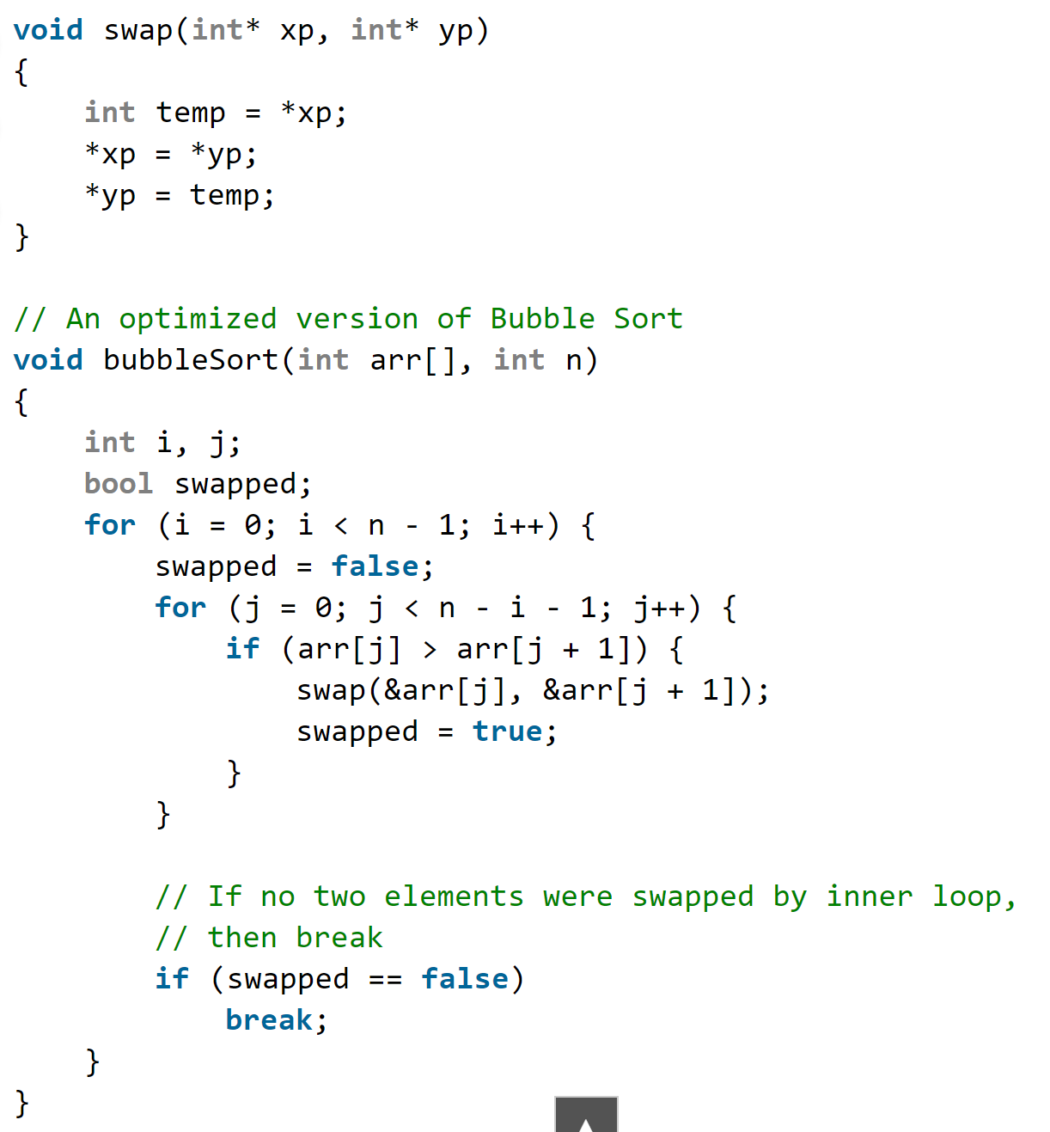
Optimized Version

Slide 9
Selection sort
Efficient sorting Algorithm.
It works by repeatedly selecting the smallest (or largest) element from the unsorted portion of the list and moving it to the sorted portion of the list.

Slide 10
Working example: On board

Slide 11
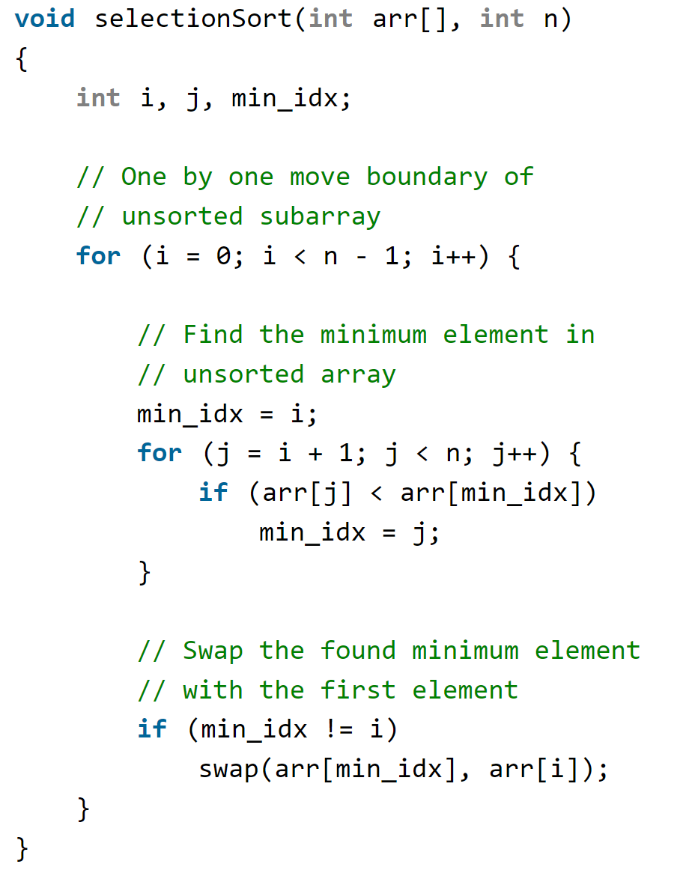
Code discussion:

Slide 12
Complexity and analysis
Time Complexity: O(N²), O(N²), O(N²)
Auxiliary Space: O(1)
Advantages of Bubble Sort:
  Simple and easy to understand.
  Works well with small datasets
  In place: It does not require any additional memory space.
Disadvantages of Bubble Sort:
  Selection sort has a time complexity of O(n^2) in the worst and average case.
  Does not work well on large datasets.
  Does not preserve the relative order of items with equal keys which means it is not stable.

Slide 13
Insertion sort
The array is virtually split into a sorted and an unsorted part. Values from the unsorted part are picked and placed at the correct position in the sorted part.

Slide 14
Working example: On board

Slide 15
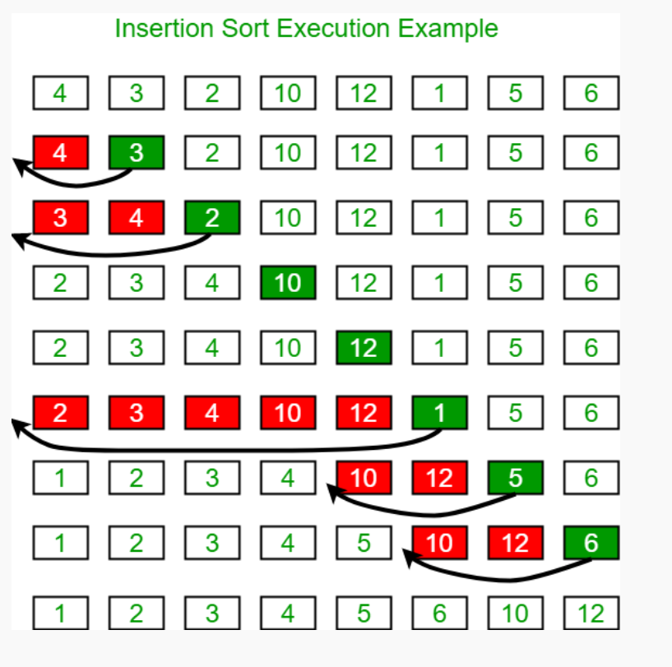

Slide 16
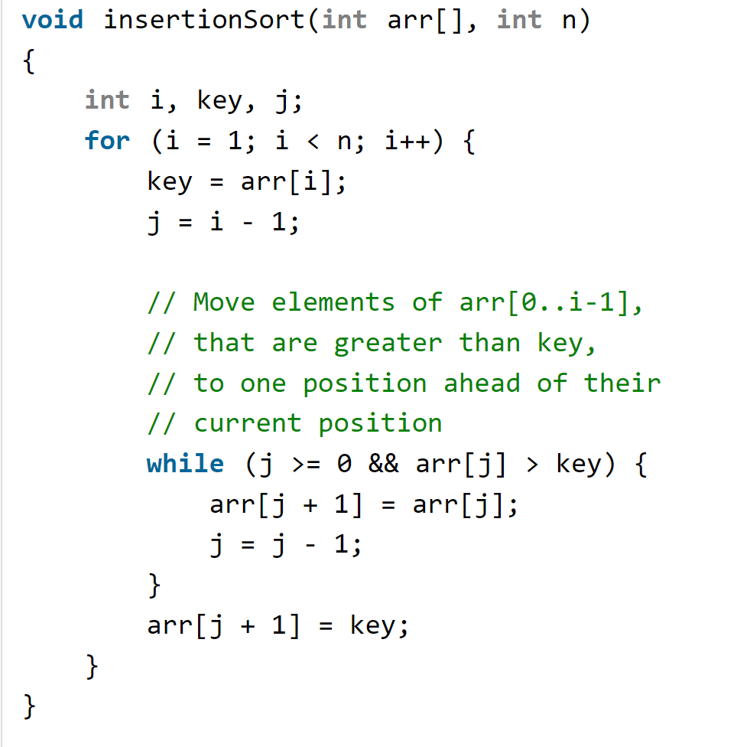
Code discussion:

Slide 17
Complexity and analysis
Time Complexity: O(N),O(N²), O(N²)
Auxiliary Space: O(1)
Advantages of Bubble Sort:
  Insertion sort is used when number of elements is small.
  Insertion sort is adaptive in nature, i.e. it is appropriate for data sets that are already partially sorted.
  In place: It does not require any additional memory space.
  Stable: insertion sort is a stable sorting algorithm.
Disadvantages of Bubble Sort:
  Does not work well on large datasets.

Slide 18
Shell sort
Covered in class

Slide 19
Comb Sort
Covered in class.

